Slide 1
CAS Admissions
Update
Colonel Art Primas
USAFA/RR
8 Oct 2019

Slide 2
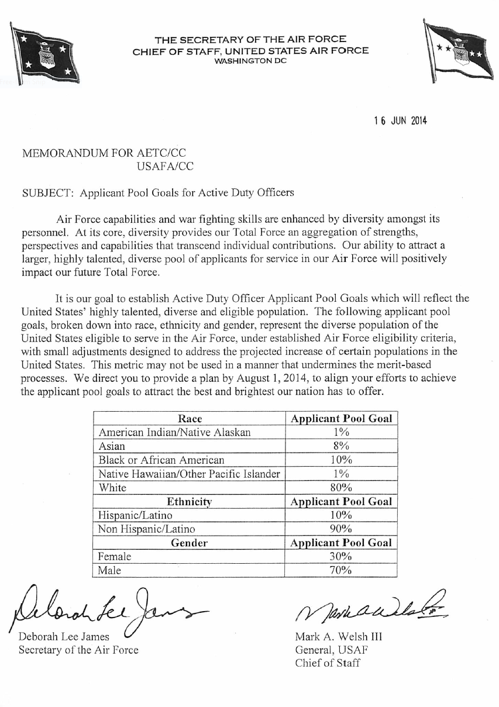
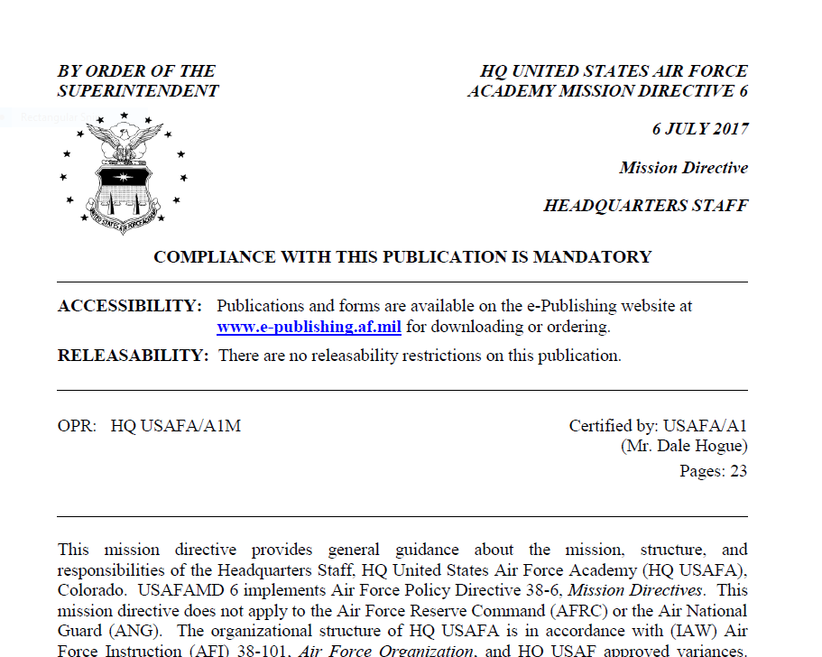
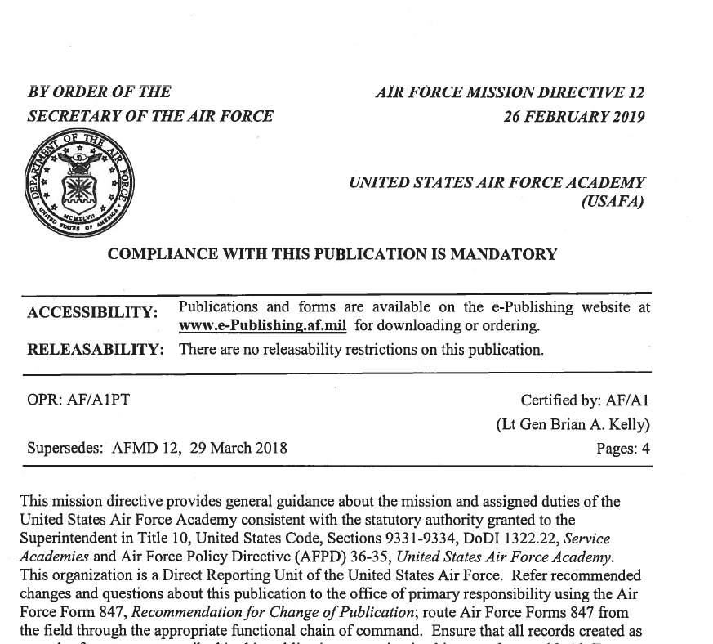
SECAF Applicant Pool Goals USAFAMD6 and AFMD12
Add first page of MD-12

Slide 3
USAFA Class of 2019-2023
Applicant Pool** vs USAF Goals
Race | USAF Goal | Applicant Pool for Class of
 |  | 2019 | 2020 | 2021 | 2022 | 2023
American Indian / Native Alaskan | 1% | 2.1% | 1.3% | 1.3% | 1.3% | 1.2%
Asian | 8% | 8.3% | 8.5% | 9.1% | 9.6% | 9.9%
Black or African American | 10% | 13.9% | 15.0% | 15.3% | 13.5% | 13.3%
Native Hawaiian / Other Pacific Islander | 1% | 1.8% | 1.8% | 1.3% | 1.6% | 1.8%
Ethnicity
Hispanic / Latino | 10% | 12.0% | 12.7% | 12.9% | 13.1% | 13.3%
Gender
Female | 30% | 26.5% | 28.7% | 29.4% | 30.3% | 31.2%
** Excludes Internationals
Notes:
Emphasize “Applicant Pool” Goals.
Other “goals”/”quotas” are not allowed by law and Air Force policy.
Actual Appointments are governed by law (U.S. Code Title X and EO Law) and are not linear to “Applicant Pool” representation.

Slide 4
USAFA Class of 2023 Acceptances (as of 18 Jul 19)
Acceptances = 1135**
** Excludes Internationals & Turnbacks
Gender
Female = 321 (28.3%)
Male = 814 (71.7%)
Ethnicity (Self-Identified)
Hispanic = 119 (10.5%)
Not Hispanic = 1016 (89.5%)
Race (Self-Identified)
All Minorities = 364 (32.1%)
Black = 119 (10.5%)
Native American = 5 (0.5%)
Asian = 104 (9.2%)
Pacific Islander = 17 (1.5%)
Declined Response = 20 (1.8%)
Medical Status
Potential Pilot = 720 (63.4%)
Nav Qual= 18 (1.6%)
Comm Qual = 397 (35.0%)
Athletes = 284 (25.0%)
Language (Primary other than English)
Akan, TWI, American Sign Language, Arabic, Both English and Spanish, Chinese, Czech, French, German, Hindi, Japanese, Korean, Polish, Punjabi, Romanian, Russian, Spanish, Tagalog, Vietnamese
First Generation College = 174 (15.3%)
Single Parent Family = 140 (12.3%)
Airmen= 66 (5.8%)
Legacy (Acad Grad Parent)= 88 (7.8%)
USAFA = 65 (5.7%); USMA = 18 (1.6%);
USNA = 3 (0.3%); USCGA = 1 (<0.1%);
USMMA = 2 (0.2%)

Slide 5
AF Prep Acceptances Class of 2020 (as of 18 Jul 19)
Acceptances = 240
Gender
Female = 50 (20.8%)
Male = 190 (79.2%)
Ethnicity (Self-Identified)
Hispanic = 50 (20.9%)
Not Hispanic = 190 (79.2%)
Race (Self-Identified)
Black = 68 (28.3%)
Native American = 0 (0.0%)
Asian = 20 (8.3%)
Pacific Islander = 8 (3.3%)
All Minorities = 146 (60.8%)
Declined Response = 0 (0.0%)
Medical Status
Potential Pilot Qual = 149 (62.1%)
Nav Qual = 0 (%)
Comm Qual = 91 (37.9%)
Athletes= 105 (43.8%)
Language (Primary other than English)
Chinese, Filipino, French, Italian, Korean, Latin, Portuguese, Spanish, Swahili, Tagalog, Yoruba
First Generation College = 86 (35.7%)
Single Parent Family = 44 (18.3%)
Airman = 52 (21.6%)
Legacy (Acad Grad Parent) = 9 (3.7%)
USAFA = 5 (2.1%); USMA = 2 (0.8%);
USNA 1 = (0.4%); USCGA = 0 (0.0%);
USMMA = 1 (0.4%)

Slide 6
Falcon Foundation Acceptances Class of 2020 (as of 18 Jul 19)
Medical Status
Potential Pilot Qual = 67 (93.1%)
Comm Qual = 2 (2.8%)
Undetermined = 3 (4.1%)
Athletes = 4 (5.6%)
Language (Primary other than English)
Filipino, Korean, Spanish
First Generation College = 9 (12.5%)
Single Parent Family = 10 (13.9%)
Legacy (Acad Grad Parent) = 5 (6.9%)
USAFA = 5 (6.9%); USMA = 0 (0.0%);
USNA = 0 (0.0%); USCGA = 0 (0.0%);
USMMA = 0 (0.0%)
School (by choice)
NM Military Inst = 4 Northwest Prep = 43
Randolph-Macon = 9 Marion = 11
Georgia Military = 5
Acceptances = 72
Gender
Female = 28 (38.9%)
Male = 44 (61.1%)
Ethnicity (Self-Identified)
Hispanic = 14 (19.4%)
Not Hispanic = 58 (80.6%)
Race (Self-Identified)
Black = 5 (6.9%)
Native American = 2 (2.8%)
Asian = 8 (11.1%)
Pacific Islander = 2 (2.8%)
All Minorities = 31 (43.0%)
Declined Response = 0 (0.0%)

Slide 7
Total Force Recruiting Strategic Intent
Total Force Recruiting Integration
Capture talent by offering comprehensive Air Force accession opportunities to prospects
Aligns AF efforts to integrate (AD/AFRC/ANG/Civilian Service)
Capitalize on fielded resources – manpower, knowledge, $$$
De-confliction & consistency for messaging, events, & coverage
Integration into the RIGHT events as well as OPPORTUNE events
Increase the diversity of the qualified candidate pool for USAFA selections
Accomplished through relationships…with applicants, influencers, AFRS, AFROTC Gold Bars, congressional district offices and Admissions Liaison Officers (ALO)
Admissions Advisors play a vital role in making this reality

Slide 8
Admission Advisor Program Evolution
Prior USAFA Recruiting Approach:
15 Admissions Advisors (First Year Lts (FYLs)) - recent USAFA graduates stationed at USAFA for 10-12 month assignment
5 geographic regions covered from USAFA
TDYs to conduct outreach
Weeks of planning for average 3-5 day outreach
Data-driven for planning and execution
New USAFA Recruiting Approach:
10 Admissions Advisors (FYLs) stationed across CONUS
4 FYLs at USAFA covering local recruiting events
4 FYLs stationed at USAFA focused on nationwide STEM outreach
Total Force (TF) Integration (embed w/AFRS Squadrons)
Ability to build relationships w/communities, schools, influencers
Continuous outreach: ability to flex, pivot as needed
Notes:
Previous outreach model focused on 15 USAFA-based FYLs going TDY to conduct data-driven outreach/recruiting.
New model allows for a consistent presence in the area that allows for the ability to build and sustain relationships w/ communities, schools, influencers and congressional district offices. It also allows for the ability to quickly adapt to any opportunities, changes that may arise.

Slide 9
USAFA Admissions Operating Locations (Summer 2019)
= RD (Regional Director) Operating Location
= FYL (RR Lts) Operating Location
I n t e g r i t y - S e r v i c e - E x c e l l e n c e
Notes:
Need 24 additional Lts to field in every AFRS squadron.

Slide 10
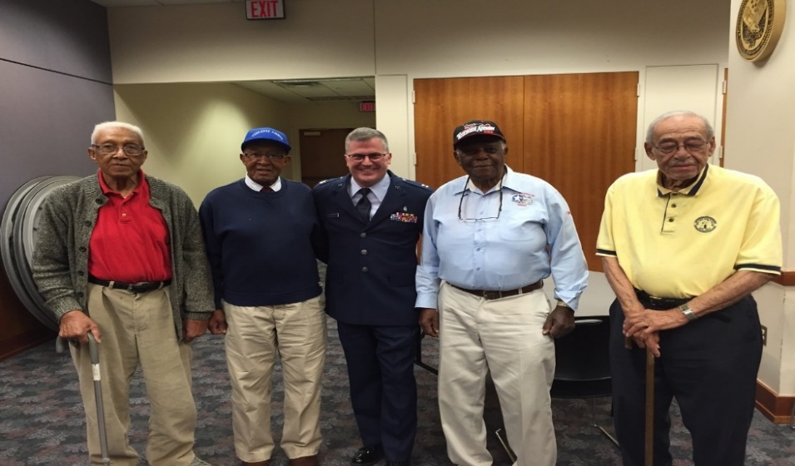
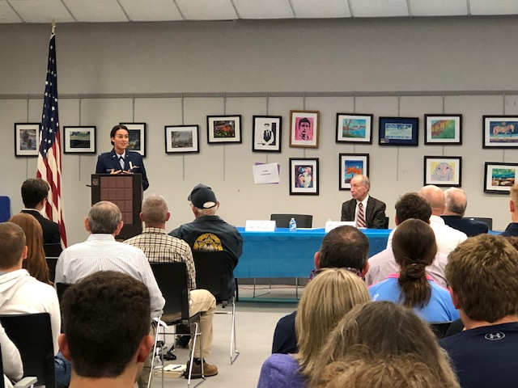
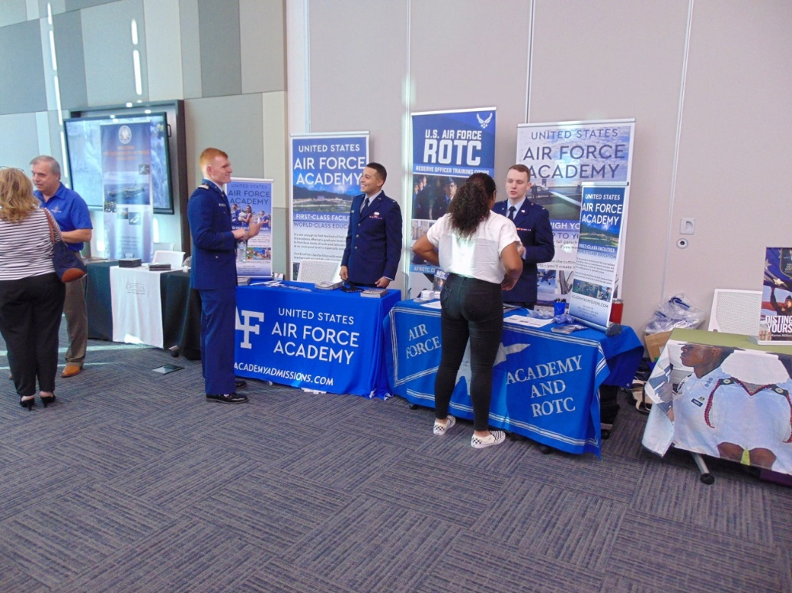
The “Picture” of Partnership
10

Slide 11
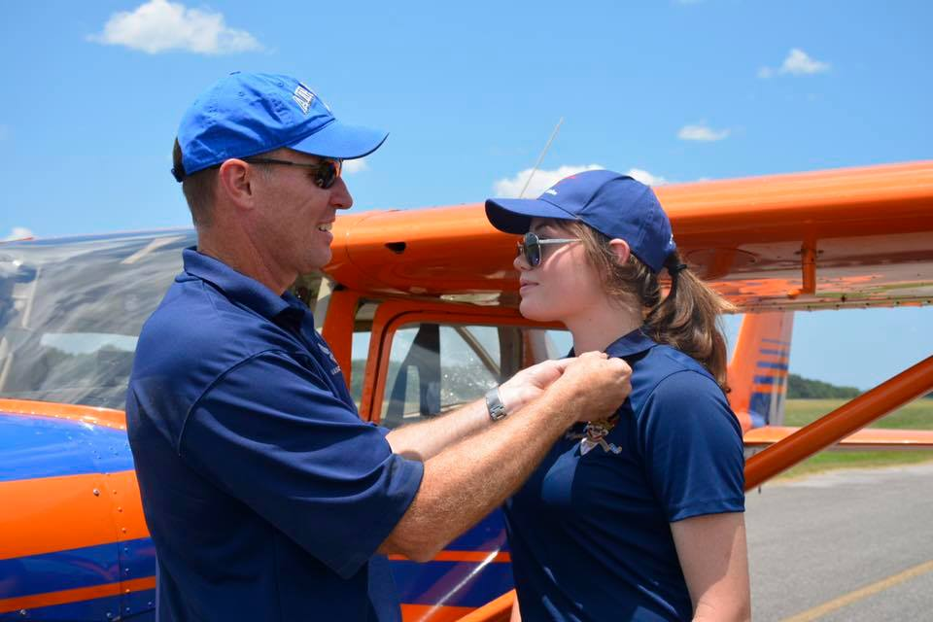
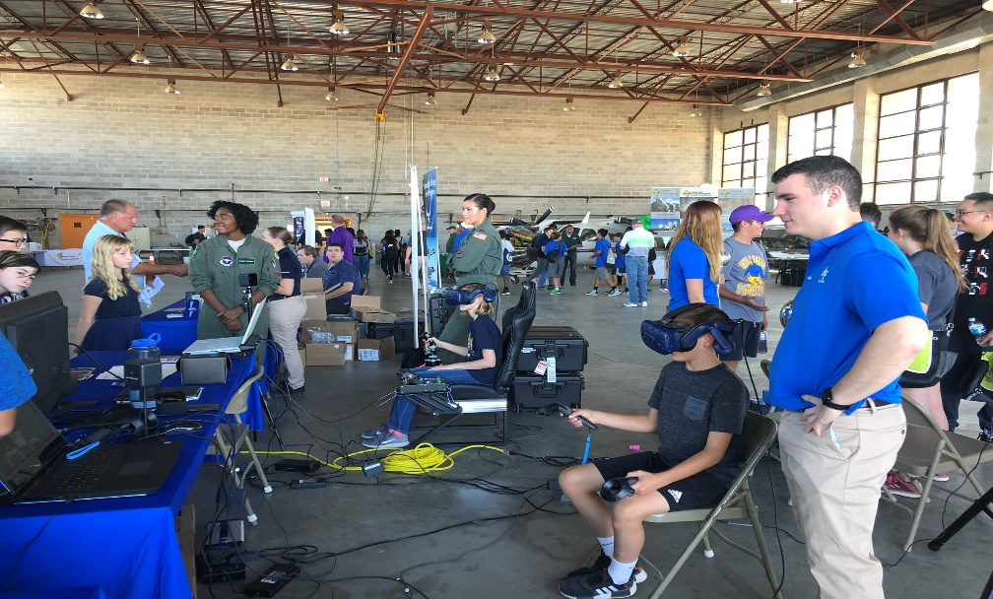
Aviation/STEM Outreach
11

Slide 12
12

