Slide 1
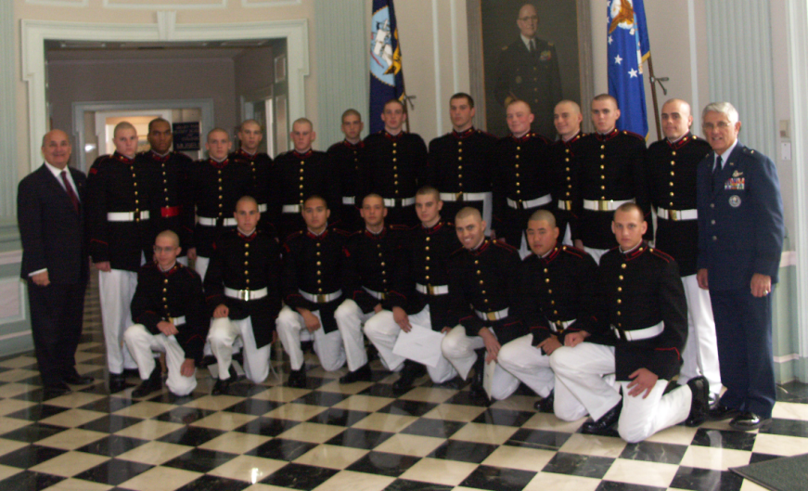
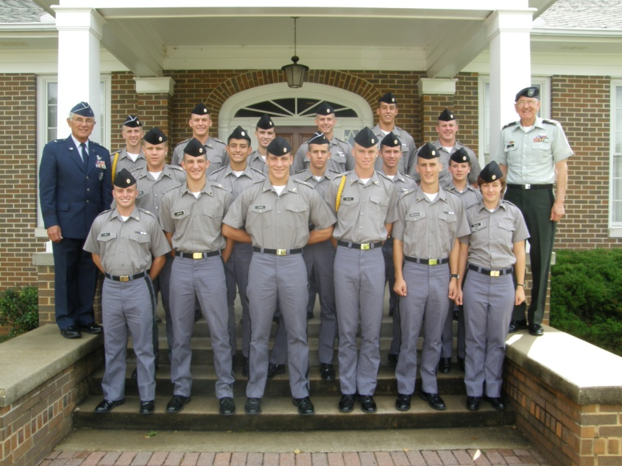
Falcon Foundation Scholarship Program

Slide 2
The Goal

Slide 3
Mission and Vision
Mission
The mission of the Falcon Foundation is to further the ability of exceptional young men and women to attend the United States Air Force Academy and pursue aerospace careers in the United States Air Force through awarding junior college and preparatory school Falcon Foundation scholarships, providing ongoing support to US Air Force Academy programs, and mentoring our Falcon scholars.
Vision
To further the development of tomorrow’s aerospace leaders through support to exceptional young people seeking to enter the United States Air Force Academy and to the Academy programs.

Slide 4
General Information
Non-profit Foundation established in 1958
Founders included prominent AF Officers of the time
160 Trustees--Foundation runs via Board of Trustees and 15 member Board of Governing Trustees.
Purpose – provide scholarships to private prep schools for motivated young people hoping to attend USAFA
Scholarships funded by endowment
Works closely with USAFA – Not part of USAFA

Slide 5
Scholarships
~100 - $5,000 scholarships awarded per year
Recipients are USAFA Qualified Candidates not selected for direct entry
Selected by USAFA Admissions Office
Scholarships used at one of five Prep Schools
Valley Forge Military Academy & College - Valley Forge, PA
Marion Military Institute - Marion, AL
Wentworth Military Academy & College – Lexington, MO
New Mexico Military Institute – Roswell, NM
Northwestern Preparatory School – Crestline , CA

Slide 6
Scholarship Selection
Student applies to USAFA
USAFA determines status
Student must be a Qualified Candidate and PPQ
ALOs perform Candidate Evaluation (Form 4060)
USAFA Admissions sends offer letters
FF receives acceptances/choice of Prep School
FF notifies Prep Schools of choice
Prep Schools sends applications to Falcon Scholars

Slide 7
USAFA Appointment
Student completes prep year at school of choice
Student reapplies to USAFA during this year
ALO re-accomplishes 4060 w/ any updated information
USAFA appoints Falcon Scholars who: *
Successfully complete their preparatory program
Meet the admissions guidelines
Obtain a nomination for the year of entry into USAFA
* Barring any unforeseen circumstances

Slide 8
Additional Programs
Foundation also funds:
Aero Engr 483 Propulsion Design Trip
Pratt & Whitney plant in Florida
Aero Engr 456 Flight Test Trip
Edwards AFB, CA
Maj Gen William J. (Bud) Breckner Lecture Series
National Character & Leadership Symposium
Management Speaker Program
In coordination w/ USAFA Management Dept
Truman Lecture Series
In coordination w/ USAFA Political Sciences Dept

Slide 9
Additional Programs
Supports USAFA diversity recruiting initiatives
Junior Falcon Scholars Program
9-10 Graders (By Admissions Office)
6-7-8 Graders (Falcon Foundation - “Reach for Tomorrow”)
Congressional Districts with Minorities (ALOs)
Air Force Motivational Field Trips (Bases)

Slide 10
Questions
www.falconfoundation.org

