Slide 1

UNCLASSIFIED//FOR OFFICIAL USE ONLY
New Visitor Center Exhibit Working Group
Ms. Lisa Neener, USAFA/CM
20 Oct 2020

Slide 2
Agenda
Background
Design Concept
Next steps
2

Slide 3
Background
Current Visitor Center built in 1980s
  Facility and exhibits outdated
  Low visitation since 9/11 due to perception of closed campus
New Visitor Center - Gateway to Colorado Springs as part of City of Champions Initiative
  EUL 50 year lease of 57 acres for private development
  Includes construction of new Visitor Center building
    Outside gate in order to remain open in high security conditions
Experience to incorporate USAFA Story, Air and Space Forces, and CO Visitor Welcome Center
  Revamp story told to the public in a holistic manner
  Increase visitation to USAFA and Pikes Peak Region

Slide 4
ME/HQ Requirements
UNCLASSIFIED//FOR OFFICIAL USE ONLY
CM – Finishings, Furnishings, Equipment (‘22 budget)
CM - Exhibits selected to tell USAFA Story & Visitor Experience (~$8M donor/corporate funding)
CE – Environmental
AD – Retail
  Fanatics and Nike contracts
  Office access
  Loading dock
A4 – Infrastructure
  Contracting (submit Oct ‘20)
  Power/cooling/heating/mech room/lighting
  Data/IT
4

Slide 5
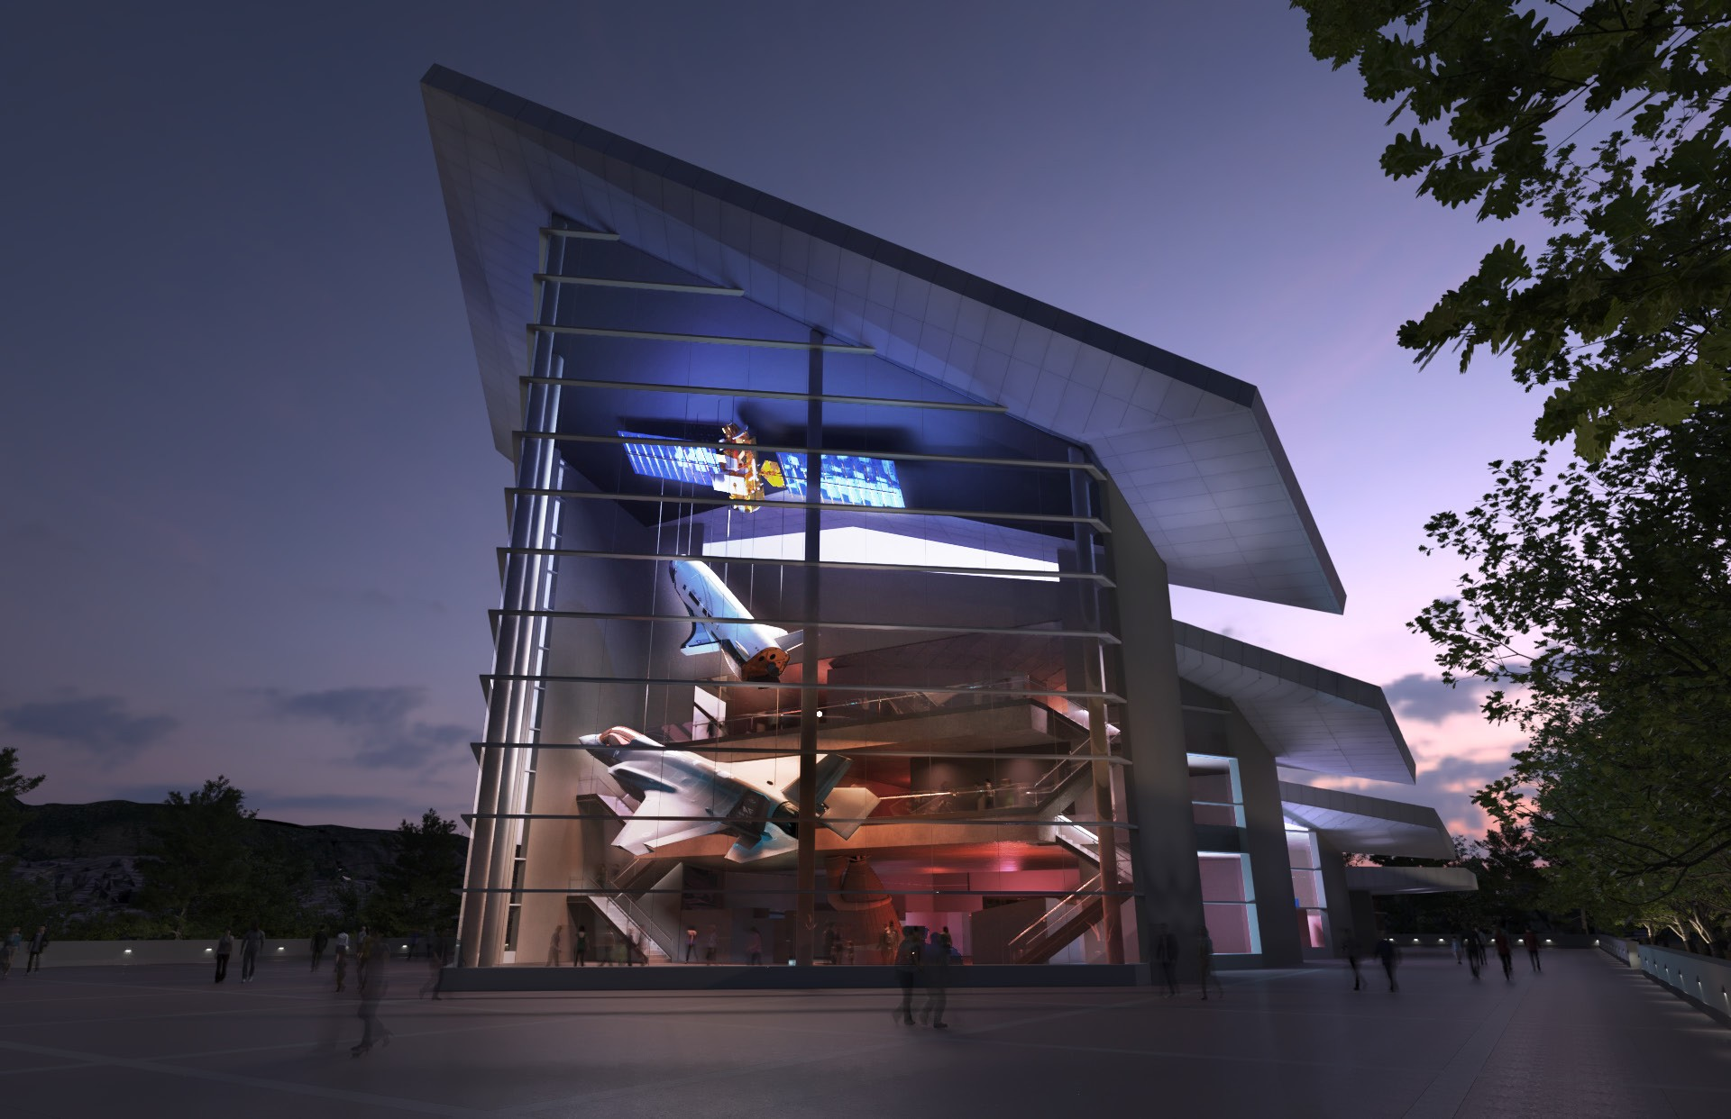
Design Overview

Slide 6
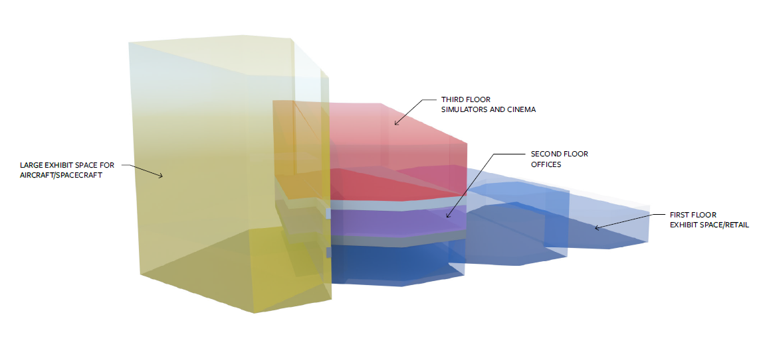
Overall Blockout

Slide 7
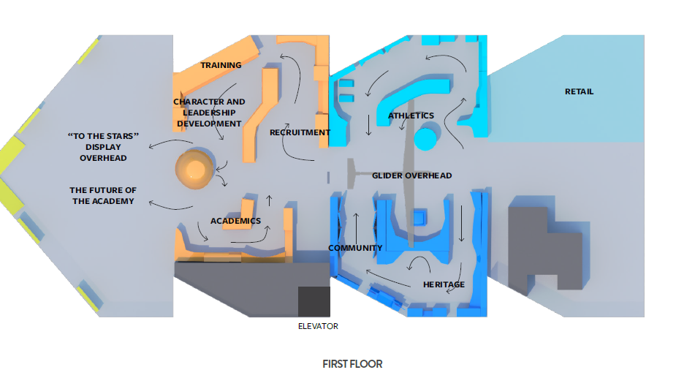
First Floor

Slide 8
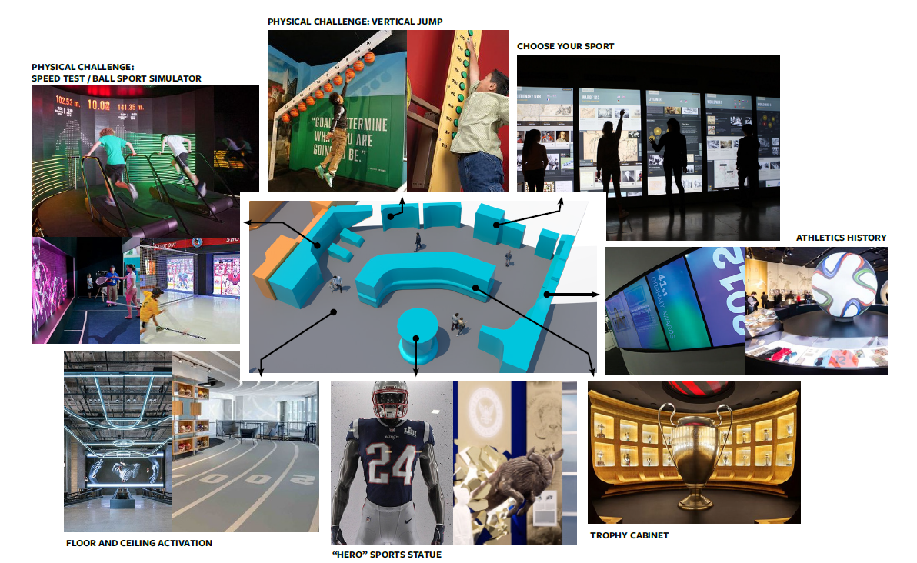
Athletics

Slide 9
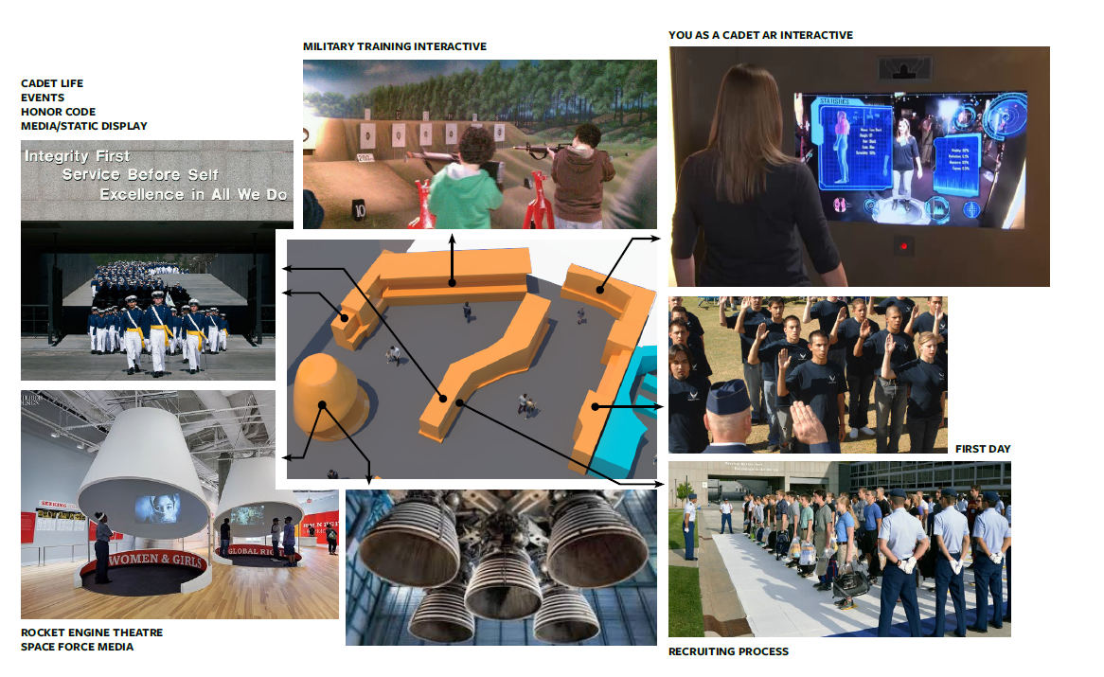
Recruitment, Training, Cadet Life

Slide 10
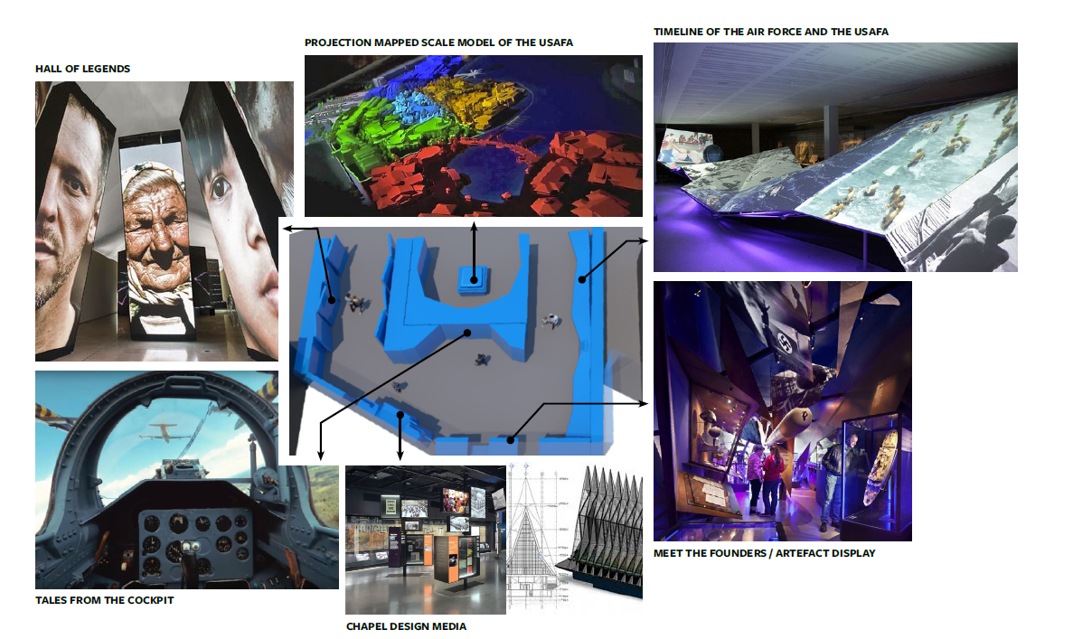
Heritage

Slide 11
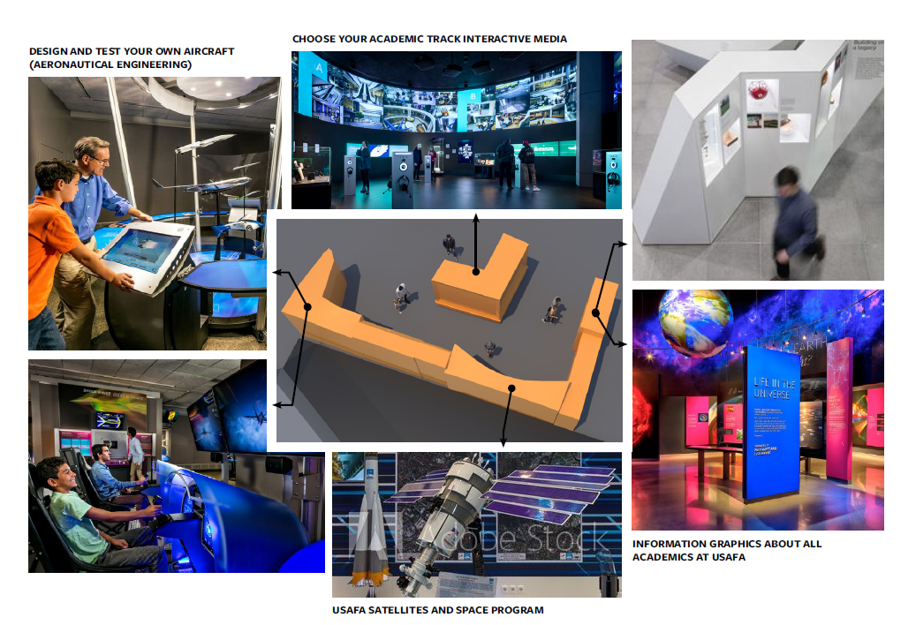
Academics

Slide 12
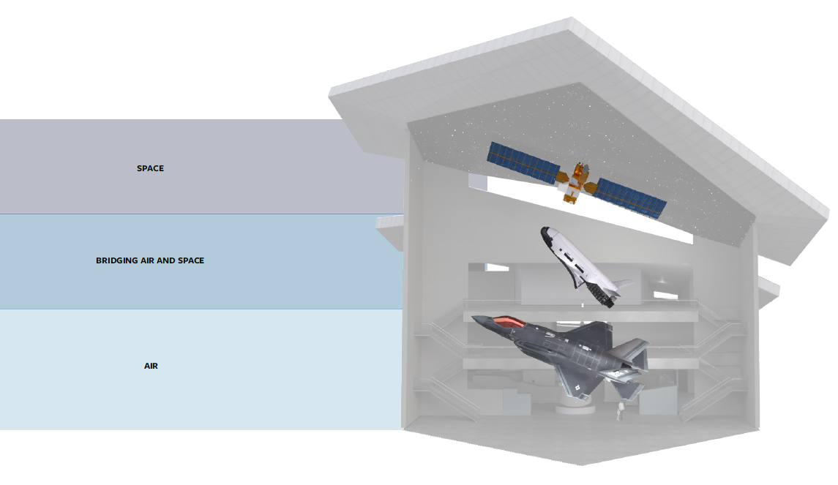
To The Stars Exhibit

Slide 13
To The Stars Exhibit

Slide 14
Next Steps
Exhibit selection
Design Development
Content creation
Estimated ground breaking ‘21
Completion NLT Dec 2023

Slide 15
Discussion

Slide 16

16

Slide 17
Backup

Slide 18
