Slide 1
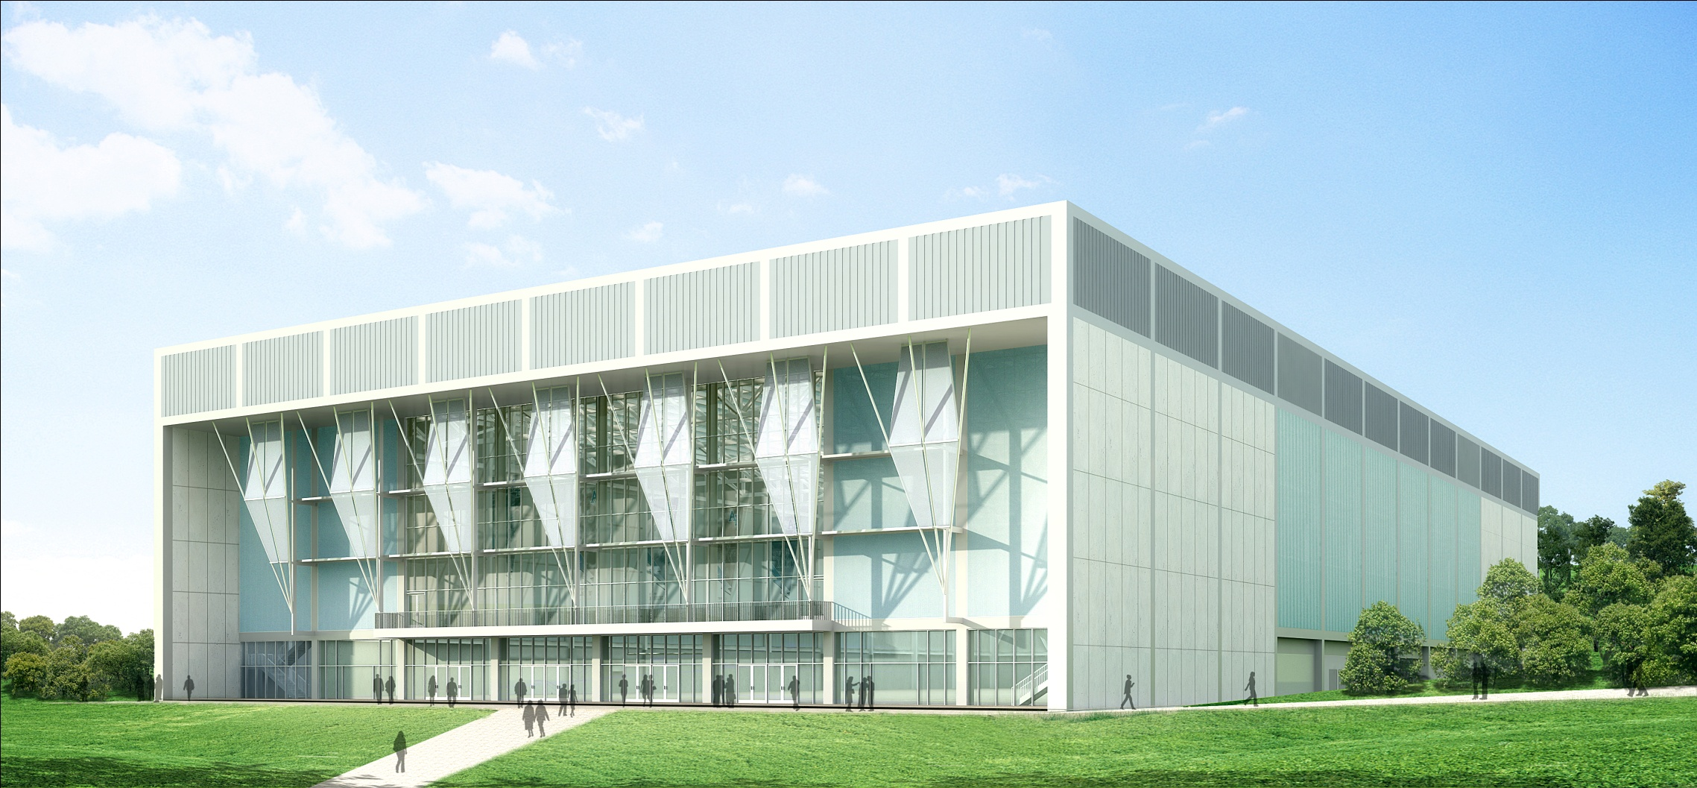

JULY 2010

Slide 2
DEVELOPMENT OVERVIEW
Fundraising Approach
Our Current Conditions
Staff
Programs
Comparison with Peers
Quarterly Results

Slide 3
FUNDRAISING – A LIFELONG PARTNERSHIP
Regular Gifts
Loyalty Based
Special Gifts
Passion Based
Ultimate Gift
Deepening Partnership
Legacy Based
20’s
40’s
60’s
80’s+

Slide 4
USEFUL BACKGROUND
Average number of consecutive years giving prior to a seven-figure gift: 8 Years
Average return for every dollar spent at mature university fundraising operations: 7 to 1
Percent of total charitable giving made by individuals (including personal foundations): 82 percent¹
Likelihood a donor who has given three years in a row will be in making a subsequent gift:
75 percent (three times as likely as donor who has given one year in a row)²
Percent of American households making a charitable donation of $25 or more: 67 percent¹
Education donors gave, on average, 1.5 percent of their income. The average amount contributed to education by these donors was $416.¹
Four out of five donors have made a gift online, and 60 percent felt charities sent too many email messages.³
  1. Giving USA, 2009
  2. University of Florida Foundation
  3. Chronicle of Philanthropy, March 2009

Slide 5
DEVELOPMENT STAFF
Development Staff: 10
Additional AOG Contract Staff: 2
Budget: $1.2 million

Slide 6
REGULAR GIFTS
Air Force Academy Fund
Any unrestricted gift
Expecting a total of $2.2 million in 2010 from approximately 4,800 donors
Sharing of funds with Academy, AOG and Endowment outlined in the MOU
Sabre Society
$1000 or more to the unrestricted fund
Currently 1,250+ individuals being recognized at this level
Will produce 55% of the total unrestricted support in 2010
Graduates
Expect a total of 4,100 graduate donors, representing 9.5 % alumni participation
Moving rapidly away from 3rd party calling program to volunteer and digital methodologies

Slide 7
REGULAR GIFTS
Parents
Expect a total of 1,800 parents donors in this calendar year to give $700,000
Heavy emphasis on four-year commitment during their cadet’s term at the Academy
Durable 3rd party calling program
What’s Needed
Experienced annual giving leadership - Greg Knedler
Deliberate transition to a broadly different approach, one that includes text messaging, digital printing, and makes better use of volunteers
Strategic communications, delivered by the Academy, the AOG and the Endowment, that make a compelling case for engagement

Slide 8
CLASS GIFTS
Legacy staff with insufficient capabilities and limited availability
A financial model that has been inconsistent, unpopular or unsustainable
No clear strategy for defining top priorities for class funding projects
Consequently, classes have adopted unambitious goals, chosen projects that often are not related to Academy or AOG priorities, and have experienced dissatisfying results
Increased staff employing a holistic approach to class engagement, including a robust effort with graduating classes, using the model from “Project 2010”
A sustainable financial model, providing sufficient unrestricted funds, while remaining consistent with the Endowment’s “no fees” DNA.
Consistent focus on Academy strategic priorities

Slide 9
MAJOR GIFTS
Jimmy Martello
Washington DC
Chicago
Minneapolis
Southern California
Boston
Dale Zschoche
Phoenix
Dallas
San Antonio
Atlanta
Florida
Alainna Rankins
Denver
Colorado Springs
Leadership Annual Giving
Mark Hille
Board of Directors
New York
Philadelphia
San Francisco
What’s Needed
Better regional coverage requires one or two additional regional major gift officers
Prospect research capabilities
Time

Slide 10
CORPORATE/FOUNDATION GIFTS
Committee chaired by Gil Mook ’67, focusing on 5-10 top targets in corporate giving
Ad hoc approaches to foundations, including El Pomar and the Gates Family Foundation
Limited staff resources available to coordinate discussion – essentially left to the major giving team
What’s Needed
At least one corporate and foundation giving officer, beginning with corporate giving
Case materials
Time

Slide 11
PLANNED GIFTS
No active program, 175 members of the Polaris Society
New employee, Dale Zschoche, has previously been a director of planned giving
Developing initial plans for a modest program in 2011
What’s Needed
Dedicated staff resources to steward existing and potential planned giving donors
Operational plan for a reinvigorated program
Leadership donors

Slide 12
A COMPARISON
WEST POINT
Development Staff: 37
Budget: $5.3 million
Raised in last decade: $276 million
Raised in 2009: $24.9 million
Funding Model:
Charge a 15% operational “tax” on all restricted gifts
Charge a 30% “tax” on Superintendent’s Fund
Income from Long Gray Line Endowment
ANNAPOLIS
Development Staff: 31
Budget: $5.4 million
Raised in last decade: $355 million
Raised in 2009: $24.4 million
Funding Model:
Assess a 5% “gift establishment fee” on restricted gifts
Use 70% of unrestricted gifts for operations
Charge 85 basis points annually on all funds held.
AIR FORCE
Development Staff: 12
Budget: $1.2 million
Raised in last decade: $70 million
Raised in 2009: $4.5 million*
Funding Model:
No fees on restricted gifts
Using 25-50% of unrestricted gifts for operations
Founding Director Fund
* Raised during a year with a fundraising budget of $486K

Slide 13
Q2 COMPARISON
(NEW CASH AND PLEDGES)
Unrestricted totals include AOG unrestricted receipts.

Slide 14
FUNDRAISING TOTALS
(CUMULATIVE AS OF 6/30/10)
Total: $23.84 million
Includes unrestricted fund totals received by the AOG during term of MOU

Slide 15
CUMULATIVE FORECAST
With the near completion of major fundraising for the Holaday Athletic Center, restricted major giving efforts will largely shift in the direction of the CCLD.
We anticipate that seven-figure gifts from individuals (including some that are part of a class effort) will begin to emerge in the 3rd quarter.
Unrestricted income will predictably rise in the fourth quarter, as we expect to meet and exceed the baseline unrestricted requirements of the MOU.
Unrestricted totals include AOG unrestricted receipts.

